Slide 1
Intro to Pivotal CF

Slide 2
Pivotal CF
Industry Trends
Cloud Foundry in Action
The Cloud Foundry Foundation
Pivotal CF
Case Studies
Overview

Slide 3
Industry Trends
What’s happening with apps today

Slide 4

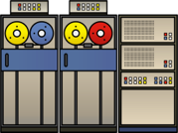
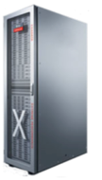
The Shift to the 3rd Generation Platform
1st
2nd
3rd
Mainframe
Client-Server
& Web
CLOUD
New Experiences
New Biz Models
New Needs (“IoT”)
pioneered by new Consumer Internet giants – requires a new Application & Data Fabrics
Automation of financial accounts
Automation of most paper processes: ERP, CRM, Email, …
$1+ Trillion of IT Spend over coming 10 years
ISAM
Relational Databases
New Data-fabrics
Mainframes
Cloud-Enabled Resources
Mini’s & PC’s

Slide 5

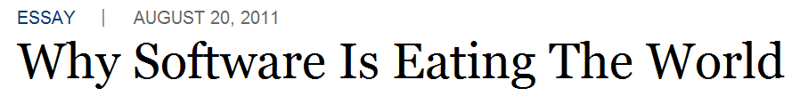
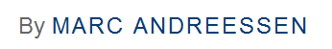
What Do We See Happening?
Cloud
You are either building a software business…
or losing to someone who is
Notes:
Here’s what’s happening. Software is eating the world, says Marc Andreesen. Every business is fundamentally becoming a software business. We believe the role that software plays inside an organization will define its future success. We only need to look at the famous examples of Amazon and Borders, Netflix and Blockbuster. iTunes and the Music Industry to see the writing on the wall for the traditional enterprise. Software is how companies engage with customers in the most meaningful and timely ways, powered by data insights and new devices. I’ll provide you with the URL to the original WSJ article. It’s a perspective we share and you may find it interesting and useful.

Slide 6


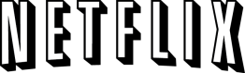
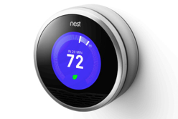
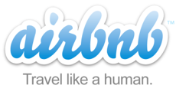

Software is Changing Industries
$3.5B valuation
Financial Services
$40B valuation
Transportation
$26B valuation
Entertainment
$3.5B valuation
Travel & Hospitality
$3.2B Acquisition by Google
Home Automation
$1.1B acquisition
Monsanto--Agriculture

Slide 7



What We’re Hearing from Customers
Need for Speed
Cloud
Enterprises are being driven to compete, innovate & execute faster than ever before:
Global reach and emerging markets
Ever-increasing customer expectations
Legacy environment & cost pressures
Mobile
Social
Big Data
At a time when we’re witnessing the most disruptive platform shifts and advances in technology in over 30 years
Notes:
Innovators like facebook, twitter & netflix have defined a new paradigm and set of expectations for technology.
User bases are growing (# of connected devices)
All of this leads to opportunity – if you can move fast enough
This new paradigm necessitated a new platform & new approach to development (3rd platform)

Slide 8




Diversity of Clients
Changing the World
In January 2014, mobile devices accounted for 55% of Internet usage in the United States. Apps made up 47% of Internet traffic and 8% of traffic came from mobile browsers.
http://money.cnn.com/2014/02/28/technology/mobile/mobile-apps-internet/
Notes:
When we established the predominant enterprise architecture paradigms, the vast majority of our clients were usually tethered to a desk with a workstation. Now that has flipped…

Slide 9
Business Expectations Exceed IT Capabilities
The Unsustainable Path for Traditional IT
IT Technology Eras
Mainframe
Client-Server
Cloud
The exponential increase in business expectations is unsustainable for IT
Millions of Apps
Billions of Users
Business Expectations
Ability of IT to Deliver S/W
Steady IT Budgets*
$ $ $ $ $ $
* Source: Gartner, 2013: “Hunting and Harvesting in a Digital World: The 2013 CIO Agenda”
Notes:
Expectations and opportunities are growing exponentially
# of Users and amount of data is also growing exponentially
Budgets are not
We need to be smarter, better, faster or risk certain death (think: blockbuster)
Be sure to explain we are in the 3rd platform era
`

Slide 10


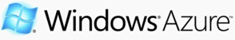

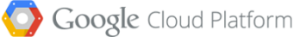
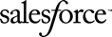


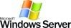
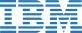

Great Software Remains Constrained by Silos
Modern Silos Hold Apps & Data Captive
Modern Silos
Legacy Silos
Captive apps and data
Closed source/proprietary
Vendor lock-in
Talent and Expertise gap
Notes:
2nd Platform vendors purposely created silos (all IBM or Oracle or nothing) stifling innovation and setting direction
3rd Platform vendors (cloud) are doing the same and making it even easier to get tied in without you realizing: e.g. use of SQS (simple queuing service) on AWS is totally proprietary
Additionally, skill sets are vendor targeted rather than agnostic.
We need to follow standards so we can be more efficient today and be prepared for the future.

Slide 11
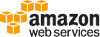
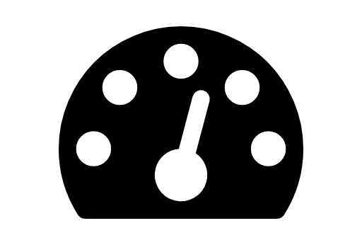

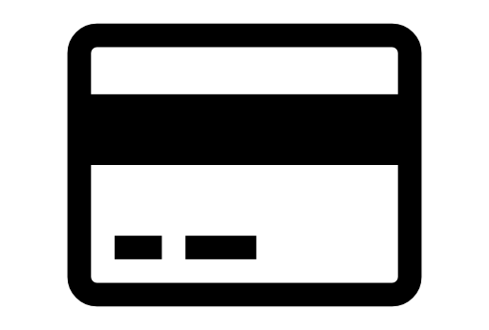


Why is AWS so Interesting?
The On-demand Revolution
Speed: True self service model allows access to resources in minutes
Cost Effective: Clear costing model with no
upfront investment required
Open: Just bring your credit card
Simple: Intuitive interfaces provide easy access to services
Global: Geographically dispersed data centers provide global reach & the promise of unlimited capacity

Slide 12

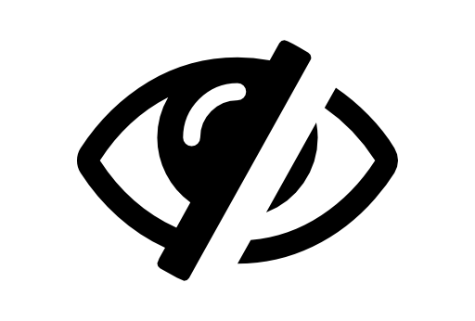

Why is AWS so Challenging?
Created by The On-demand Revolution
Divergence: A la carte options lead to differing versions of operating systems, tools & runtimes
Sprawl: Out of control costs due to 100’s or 1000’s of accounts & lack of clean
Lack of Security, Visibility & Governance: Organizations are exposed to high risk due to lack of control
Vendor Lock In: Use of proprietary services and technologies are not portable to other cloud platforms

Slide 13
Rapid Innovation requires a New Approach

Slide 14

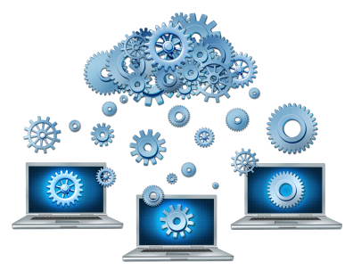
Rapid Innovation requires a New Approach
Developers
Operators
Dramatically improve developer experience
Agile teams, rapid iteration
Ingest and incubate open source advancements and new data services
Continuous delivery, no planned downtime
Instant scaling of apps and data services
Automation and deployment consistency at every step

Slide 15
Cloud Foundry in Action
The “It Just Works” Experience

Slide 16
The Power of PaaS
The “It Just Works” Experience
Traditional IT
IaaS
PaaS
Applications
Applications
You
Manage
Applications
Data
Data
Data
Agility and Cost Savings
You Manage
Runtime
Runtime
Runtime
Middleware
Middleware
Middleware
You Manage
O/S
O/S
O/S
Virtualization
Virtualization
Virtualization
Pivotal CF on IaaS
Servers
Servers
IaaS Provider
Servers
Storage
Storage
Storage
Networking
Networking
Networking
Cloud Enablement
Notes:
PaaS in its most basic sense is an extension of the IaaS pattern to include management of runtimes, middleware, configuration, etc.

Slide 17
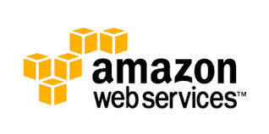
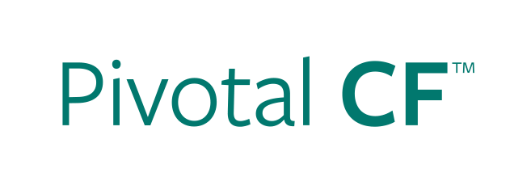

Deploying an Application
IaaS versus PaaS
Provision VM
Install Application Runtime
Deploy Application
Configure Load Balancer
cf push
Configure SSL Termination
Configure Service Connectivity
Configure Firewall
Notes:
Highlight that not only are the steps longer in IaaS, but often there are multiple groups involved (ie, Dev, Operations, etc).
Management of configuration information is often manual in IaaS (though not always).
Explain that for non-virtualized customers, the steps are even greater.

Slide 18
Scaling an Application
IaaS versus PaaS
Provision New VM
Install Application Runtime
Deploy Application
cf scale
Configure Load Balancer / Update Route
Configure Service Connectivity
Configure Firewall
Notes:
Highlight that not only are the steps longer in IaaS, but often there are multiple groups involved (ie, Dev, Operations, etc).
Management of configuration information is often manual in IaaS (though not always).
Explain that for non-virtualized customers, the steps are even greater.

Slide 19
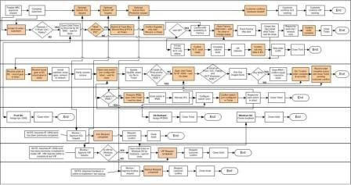
Taking the Application Lifecycles From Months…
Notes:
Speed in the market place wins. Reducing the handoff points and automating to take the application lifecycle from months <click>

Slide 20
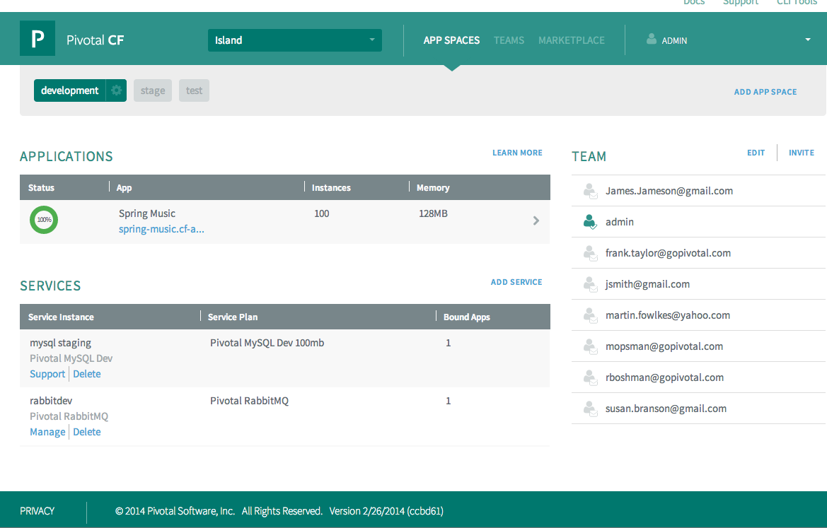
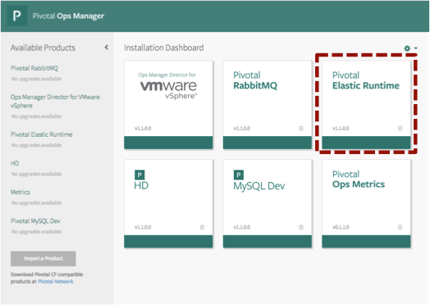

…to Hours and Minutes
Developer
Operator
Auto-select runtimes
Deploy app
Select and bind middleware
Scale app
Establish infrastructure
Provision
Add capacity
Control Auth, Policies, HA
App Deployment: 30-90 seconds
Cloud Deployment: 2-4 hours
Notes:
To Hours and Minutes where
A developer can just push their application and the platform Auto-select runtimes, Deploys app, provides a simple step to select and bind middleware.
And the operator can very quickly Establish infrastructure, Provision and Add capacity on demand with out downtime
Every app can be Scaled instantly while having all the enterprise Control, Authorization, Policies and HA requirements applied

Slide 21
Cloud Foundry
The community and ecosystem

Slide 22
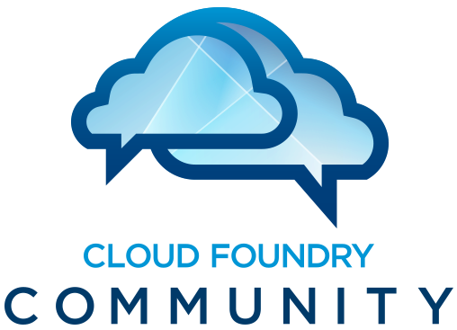
Cloud Foundry
The Open Platform

Slide 23
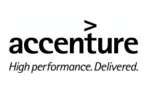

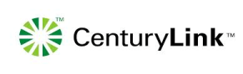
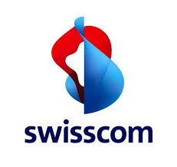


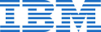
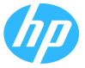
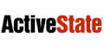





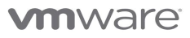


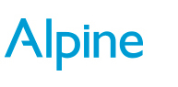

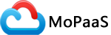


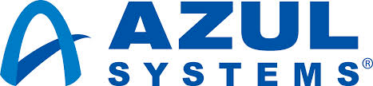
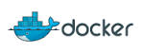
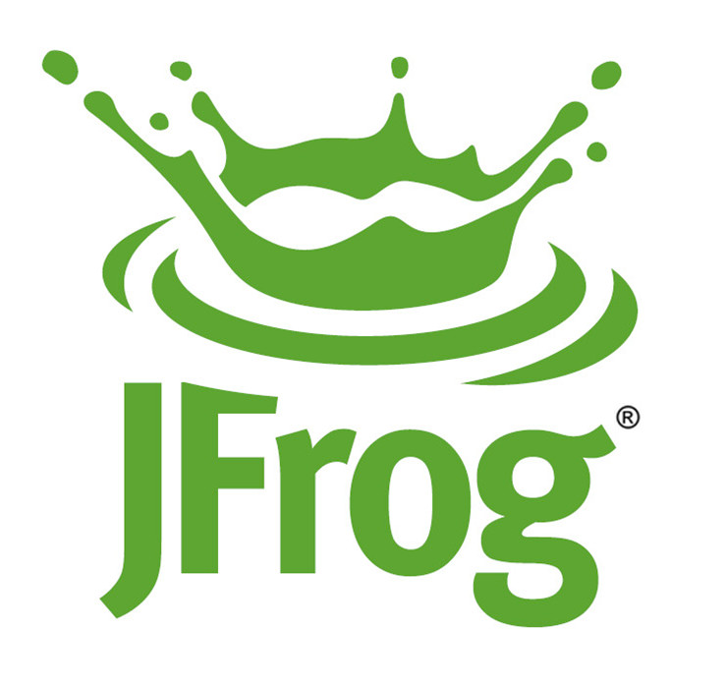
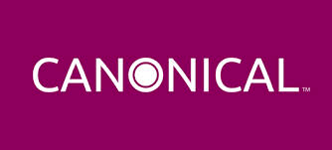
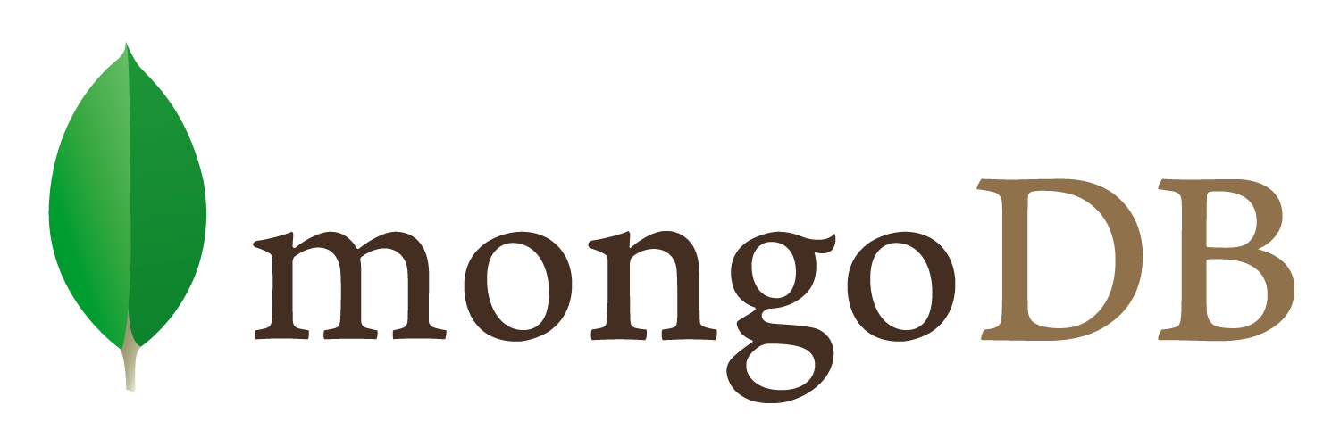
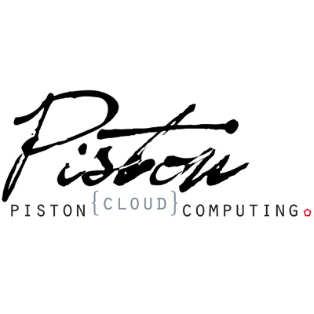



The Cloud Foundry Foundation
The Largest Open Source PaaS Ecosystem
Platinum members
Gold members
Anchora
Silver members
Over 100k downloads of Cloud Foundry (OSS) software and tools!
Notes:
Rich open source heritage. Industry support to become defacto cloud platform.

Slide 24
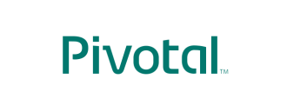
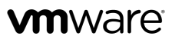
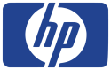






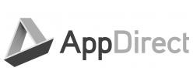
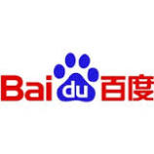
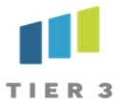


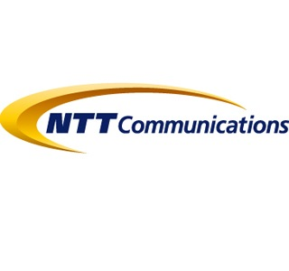
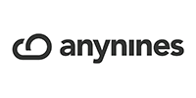
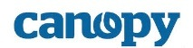
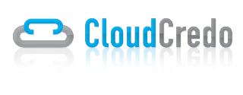
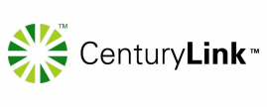
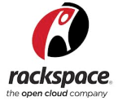












The Largest Open Source PaaS Ecosystem
Driven by the Community
Notes:
CloudFoundry is the defacto PaaS stanard supported & adopted by an enormous community of companies.

Slide 25
Pivotal CF
Enterprise Cloud Foundry

Slide 26


The leading enterprise distribution of Cloud Foundry is.. Pivotal CF

Slide 27





Core Tenets of Pivotal CF
The Enterprise Platform as a Service
Radically Simple, Developer Friendly
Broad Ecosystem Services
Operational Benefits for Every Application
Push an app and “it just works”
Build applications that consume increasing amounts of data, supporting wide ranging use cases
Support new application patterns like Microservices
Highly scalable, self healing
Logging and audit trail requirements
Existing enterprise policies on user access & authorization
Application Monitoring and Operational metrics
Application Uptime SLAs
Data Services
App Services
Mobile Services
Easy to add and customize
Deploy, Operate, Update & Scale with minimal downtime on Any IaaS
….and more
Notes:
And finally, Pivotal CF aligns all 3 of these pillars (Dev, Services and Ops) with a common model for deployment, operations, and scale on any IaaS without changes in the application. This offers the customer a converged platform to build --- as IDC calls it -- 3rd platform applications combining cloud, mobile, big data and social. This enables the new frontier to compete via software.
CFOs and CIOs love Pivotal CF because with Enterprise, private PaaS you can unlock the investment in your own data center infrastructure as well as leverage public clouds. You can turn your own private data center into this next generation platform to speed innovation.
Pivotal CF is multi-cloud which means you don’t have to decide at development time which cloud your app will run on. And you can move apps dynamically to the best cloud for the app, based on price, security, SLAs. Today, development on current IaaS means you build vendor-specific infrastructure calls into each app. Conversely, with Pivotal CF, the multi-cloud portability gives you freedom to move clouds and ensures you don’t get locked in as you build, or to go with lower cost or other best fit criteria. Pivotal CF does this by abstracting the IaaS layer from each provider with 14 API calls.
Here’s a good cost/opportunity example: Do you recall why Amazon dropped their prices by 45% last year? Because the day before, Google had announced their price drop of 50%. So as a CFO, you want to take advantage of any price war and not have to choose ahead of time. You want to have the flexibility, to not only take advantage of your dc but take advantage of lowest cost public cloud as you like.
Put this 4 pillars together and you have a great value story for both application developers and cloud operators; as well as the IT Executive Buyers. Lets recap:
First for developers. The Developer experience is where PaaS historically has focused, keeping developers happy with a revolutionary faster and simpler experience of how they deploy
Second, this idea of an infinitely extensible ecosystem of Services comes to the enterprise. This Extensibility is going to keep CTOs happy because she is going to want to have rapid access to the newest technologies.
Third, Pivotal CF gives Cloud Operators a more efficient way of managing apps that abstracts them from individual VM maintenance. Built in to every app is auto scaling, auto healing, 4 levels of high availability. This makes IT Teams magnitudes more efficient and ensures that all technologies meet enterprise standards, while giving developers the flexibility they need to innovate.
And finally, CFOs and CIOs love Pivotal CF because with Enterprise, private PaaS you can unlock the investment in your own data center infrastructure as well as leverage public clouds. You can turn your own private data center into this next generation platform to speed innovation.

Slide 28
Commercially Supported Enterprise PaaS by Pivotal
Certified upgrades, curated & tested quarterly releases
Operations Manager Cloud Administrative Console
Elastic Runtime Users Console
Built-in Application Performance Monitoring (APM)
Operational Metrics service
Auto-Scaling service
Easy LDAP/Active Directory Integration
Historical Usage Data per Application Instance
Declarative Availability Zones
Behind the firewall download packages (do not require internet access)
Enterprise documentation (PDF format)
Notes:
Note to Pivotal Field:
Our advise is to always start this discussion with PCF as the leading (with a huge head start) commercial version for Enterprises of OSS CF and that customer don’t want rely on OSS non-commercially supported codebase for their enterprise deployments. You way use the RHEL == PCF; OSS CF == Linux analogy. Only then you should talk about specifics of “what’s beyond OSS
==== © Matt Rieder ===
Anyone who has attempted to construct production ready Cloud Foundry releases, including original and subsequent BOSH manifests, for each independent component and the entire holistic open source project, knows the true worth of PCF.
PCF releases are tested within each core team before they are passed to an release engineering team to test the integration of these releases across products and infrastructures. When full integration fails, fixes are committed within an individual team, and re-tested across the full spectrum. Release engineering has also built a continuous integration pipeline to test that an existing installation can be upgraded by Ops Manager and CF BOSH between and across minor releases.
Attempting to reproduce Pivotal's release pipeline, through which a certified release is published, would require institutional knowledge, expertise, and feedback loops that are nonexistent outside of this organization. It is possible that an external team could monitor Cloud Foundry's discussion groups, watch the public trackers, report on integration problems between commits they felt were ready for a production system, patch problems, submit pull requests, build and run integration tests with each individual and cross component change, hand craft BOSH manifests for each turn of the crank, and replace Ops Manager with scripts that upgrade those manifests after discussing the properties that need modification.

Slide 29
















Pivotal CF Services
Not Pictured: Ops Metrics for JMX monitoring

Slide 30
Case Studies

Slide 31

1 Billion Page Views A Day Powered by Cloud Foundry!
Notes:
Is CF ready for prime time? Baidu is the largest web property in China and serves 1 billion page views a day w/ Cloud Foundry

Slide 32


90%
Reduction in Operation Costs
$
Big Cost Saving
Dramatic increase in Server to Admin ratio
Notes:
Rakuten traditional process on lhs – developer asks infrastructure team to request servers, make a VM, install middleware, configure the load balancers and so on. Developers are out of the deployment workflow in the company.
After they introduced rPaaS with Cloud Foundry, the developer just says “push his application(s)” to deploy their applications. Some of the developers integrated push with Jenkins so everything in the deployment process is automated.
As a result, from actual users they saved on infrastructure operation costs/reduced by 90%. Benefits not only for application developers but for infrastructure engineers to free up time to develop new things for infrastructure.

Slide 33






Fail, Learn, Adapt, Repeat.
6 Months to 6 Weeks
$1.1M Saving per App
Notes:
Comprehensive analysis of savings over the application lifecycle lead to extremely compelling #s for Warner music

Slide 34


“IaaS without PaaS capabilities becoming a dying breed.
In 2014…IaaS providers with no PaaS services…and no ecosystem of developers will go the way of the dodo bird.”
“The single most powerful thing you can do this year is to enable your developers with a fast and flexible PaaS.
Cloud Foundry fits the bill nicely, and the ease of deployment is the same whether you're deploying a Node.js prototype or a Java project with scads of external services.”

